Slide 1
A Prophet on the Run Escaping the Presence of God
The Book of Jonah
March 19, 2023

Slide 2
Jonah 1:1-4
¹ The word of the Lord came to Jonah the son of Amittai saying, ² “Arise, go to Nineveh the great city and cry against it, for their wickedness has come up before Me.” ³ But Jonah rose up to flee to Tarshish from the presence of the Lord. So he went down to Joppa, found a ship which was going to Tarshish, paid the fare and went down into it to go with them to Tarshish from the presence of the Lord. ⁴ The Lord hurled a great wind on the sea and there was a great storm on the sea so that the ship was about to break up.

Slide 3
Jonah 1:5-7
⁵ Then the sailors became afraid and every man cried to his god, and they threw the cargo which was in the ship into the sea to lighten it for them. But Jonah had gone below into the hold of the ship, lain down and fallen sound asleep. ⁶ So the captain approached him and said, “How is it that you are sleeping? Get up, call on your god. Perhaps your god will be concerned about us so that we will not perish.” ⁷ Each man said to his mate, “Come, let us cast lots so we may learn on whose account this calamity has struck us.” So they cast lots and the lot fell on Jonah.

Slide 4
Jonah 1:8-10
⁸ Then they said to him, “Tell us, now! On whose account has this calamity struck us? What is your occupation? And where do you come from? What is your country? From what people are you?” ⁹ He said to them, “I am a Hebrew, and I fear the Lord God of heaven who made the sea and the dry land.” ¹⁰ Then the men became extremely frightened and they said to him, “How could you do this?” For the men knew that he was fleeing from the presence of the Lord, because he had told them.

Slide 5
Jonah 1:11-13
¹¹ So they said to him, “What should we do to you that the sea may become calm for us?” for the sea was becoming increasingly stormy. ¹² He said to them, “Pick me up and throw me into the sea. Then the sea will become calm for you, for I know that on account of me this great storm has come upon you.” ¹³ However, the men rowed desperately to return to land but they could not, for the sea was becoming even stormier against them.

Slide 6
Jonah 1:14-17
¹⁴ Then they called on the Lord and said, “We earnestly pray, O Lord, do not let us perish on account of this man’s life and do not put innocent blood on us; for You, O Lord, have done as You have pleased.” ¹⁵ So they picked up Jonah, threw him into the sea, and the sea stopped its raging. ¹⁶ Then the men feared the Lord greatly, and they offered a sacrifice to the Lord and made vows. ¹⁷ And the Lord appointed a great fish to swallow Jonah, and Jonah was in the stomach of the fish three days and three nights.

Slide 7
A Prophet on the Run
I. Sovereign to Send
II. Sovereign to Save
III. Sovereign to Spare
IV. Sovereign to Scold

Slide 8
Matthew 12:38-41
³⁸ Then some of the scribes and Pharisees said to Him, “Teacher, we want to see a sign from You.” ³⁹ But He answered and said to them, “An evil and adulterous generation craves for a sign; and yet no sign will be given to it but the sign of Jonah the prophet; ⁴⁰ for just as Jonah was three days and three nights in the belly of the sea monster, so will the Son of Man be three days and three nights in the heart of the earth. ⁴¹ The men of Nineveh will stand up with this generation at the judgment, and will condemn it because they repented at the preaching of Jonah; and behold, something greater than Jonah is here.

Slide 9
A Prophet on the Run
I. Sovereign to Send (1:1-17)
A. The Prophet (1:1-3)
1. Arise – Prepare for the service that God is calling, it is a standby command.
2. Go – “Go to Nineveh” pinpoints the location of the call.
3. Cry – “Cry against it” an order to call, announce, or proclaim some message of judgment upon Nineveh.

Slide 10
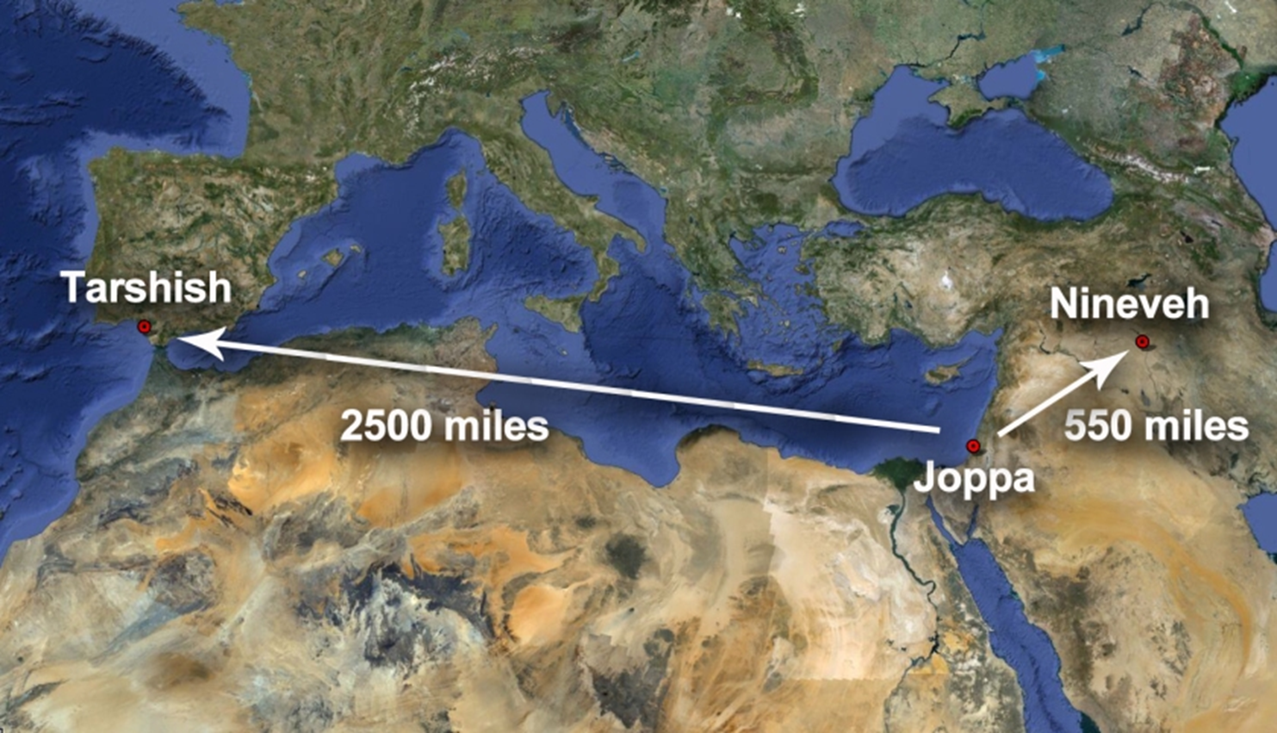
A Prophet on the Run

Slide 11
A Prophet on the Run
I. Sovereign to Send (1:1-17)
A. The Prophet (1:1-3)
B. The Storm (1:4-16)

Slide 12
Matthew 8:23-26
²³ When He got into the boat, His disciples followed Him. ²⁴ And behold, there arose a great storm on the sea, so that the boat was being covered with the waves; but Jesus Himself was asleep. ²⁵ And they came to Him and woke Him, saying, “Save us, Lord; we are perishing!” ²⁶ He said to them, “Why are you afraid, you men of little faith?” Then He got up and rebuked the winds and the sea, and it became perfectly calm.

Slide 13
A Prophet on the Run
I. Sovereign to Send (1:1-17)
A. The Prophet (1:1-3)
B. The Storm (1:4-16)

Slide 14
A Prophet on the Run
I. Sovereign to Send (1:1-17)
A. The Prophet (1:1-3)
B. The Storm (1:4-16)
C. The Fish (1:17)

Slide 15
A Prophet on the Run Escaping the Presence of God
The Book of Jonah
March 19, 2023

